Slide 1


Object-Oriented Programming in Python

Slide 2




1. Introduction to OOP in Python
1
Object-Oriented Programming (OOP) organizes code into classes and objects.
2
Core principles:
• Encapsulation: group related data and methods.
• Inheritance: create new classes from existing ones.

Slide 3
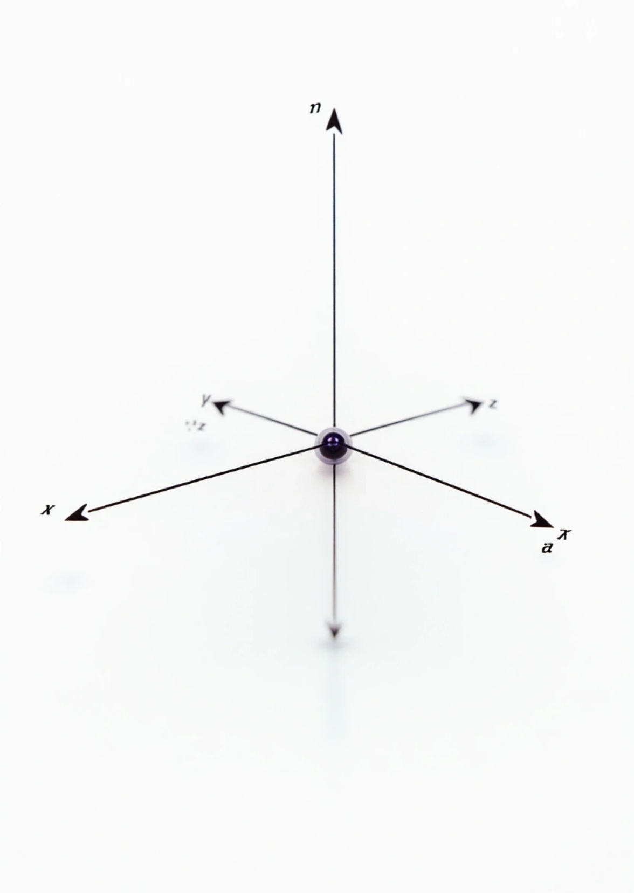



2. Creating the Base Class — Point3D
Define a 3D point with x, y, and z coordinates.
class Point3D:
def _init_(self, x, y, z):
self.x = x
self.y = y
self.z = z
1
2
The constructor _init_ initializes the coordinates.
Each object of Point3D represents a point in 3D space.

Slide 4

3. Understanding self
self represents the instance of the class.
It allows access to instance variables and methods.
Example
def display(self):
print(f"Point3D: ({self.x}, {self.y}, {self.z})")
Here, self.x, self.y, and self.z refer to the object’s own data.

Slide 5

4. Displaying and Moving a 3D Point
class Point3D:
def _init_(self, x, y, z):
self.x, self.y, self.z = x, y, z
def display(self):
print(f"Point3D: ({self.x}, {self.y}, {self.z})")
def move(self, dx, dy, dz):
self.x += dx
self.y += dy
self.z += dz
p = Point3D(2, 4, 6)
p.move(1, 1, -2)
p.display() /# Point3D: (3, 5, 4)

Slide 6

5. Adding a String Representation
class Point3D:
def _init_(self, x, y, z):
self.x, self.y, self.z = x, y, z
def sef _str_(self):
return f"({self.x}, {self.y}, {self.z})”
"
p = Point3D(1, 2, 3)
print(p) /# Output: (1, 2, 3)

Slide 7
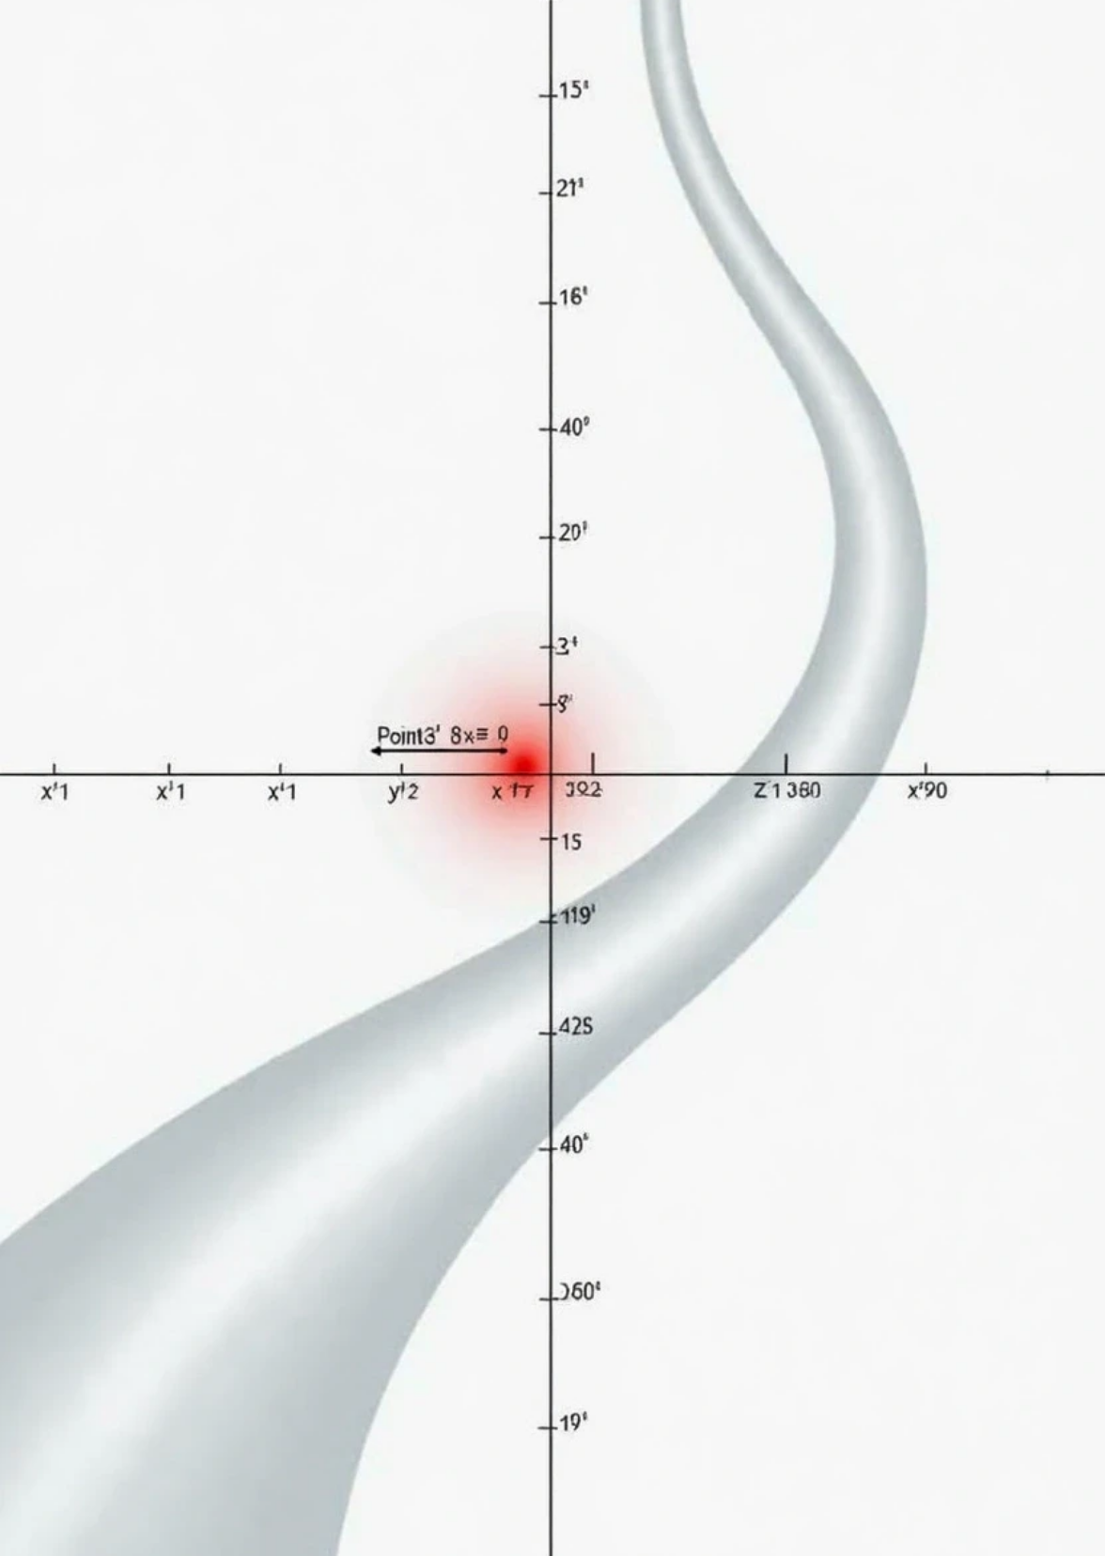


6. Creating the Derived Class — Point2D
Let’s derive Point2D from Point3D but fix z = 0.
class Point2D(Point3D):
def _init_(self, x, y):
super()._init_(x, y, 0) /# Call base class constructor
Explanation
1
super() calls the parent (Point3D) constructor.
2
Inheritance allows Point2D to reuse methods from Point3D.

Slide 8

7. Using Point2D Objects
p2 = Point2D(4, 7)
print(p2) /# (4, 7, 0)
p2.display() /# Point3D: (4, 7, 0)
Key Concept
Although it’s a 2D point, it behaves like a 3D point with z = 0.
Adding Distance Calculation
import math
class Point3D:
def _init_(self, x, y, z):
self.x, self.y, self.z = x, y, z
def distance_from_origin(self):
return math.sqrt(self.x**2 + self.y**2 + self.z**2)

Slide 9
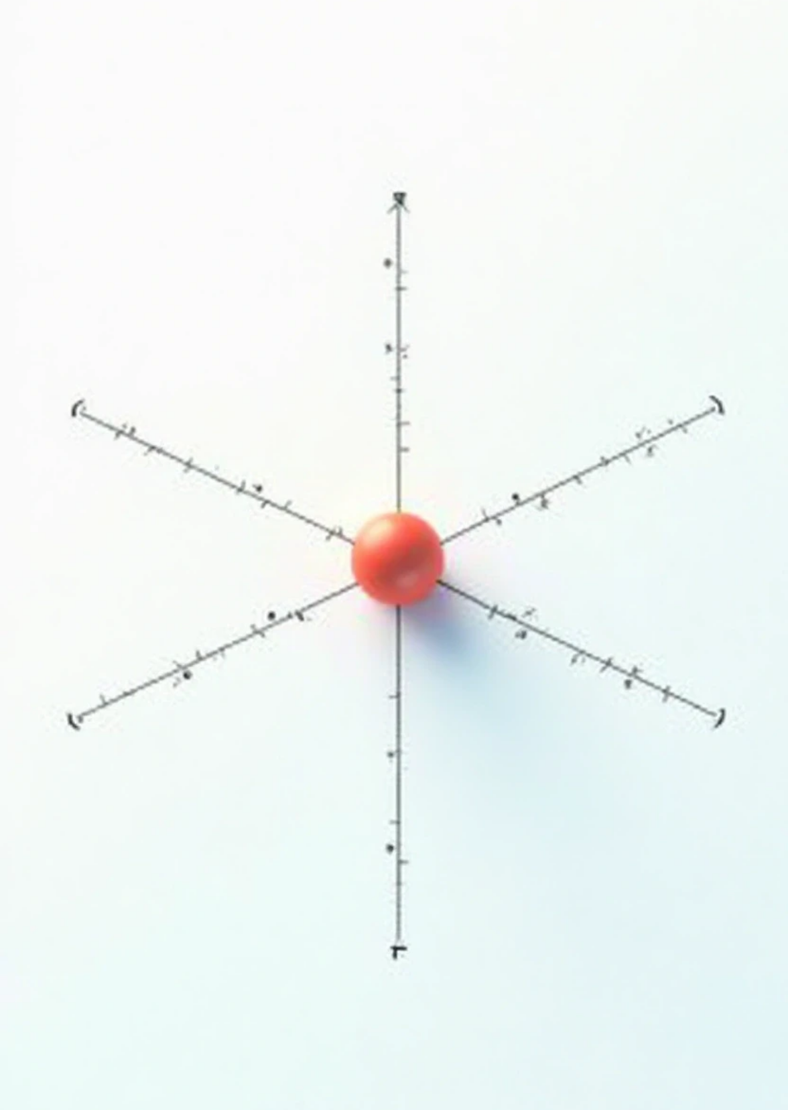
Works for both 3D and 2D points:
p3 = Point3D(3, 4, 12)
p2 = Point2D(3, 4)
print(p3.distance_from_origin()) /# 13.0 print(p2.distance_from_origin()) /# 5.0
8. Encapsulation & Private Attributes
In Python, private variables are prefixed with double underscores __.
class Point3D:
def _init_(self, x, y, z):
self.__x = x self.__y = y self.__z = z
def display(self):
print(f"Point3D: ({self.__x}, {self.__y}, {self.__z})")

Slide 10

Accessing them directly:
p = Point3D(1, 2, 3)
print(p.__x) /# ❌ AttributeError
Access safely via methods:
def get_x(self):
return self.__x

Slide 11



9. Exercise — Create a New Base and Derived Class
1
Design a base class Shape with attributes like color and a method area().
2
Derive classes like Rectangle and Circle from Shape.
3
Each derived class should override the area() method:
4
Add a _str_() method in each class to show shape information.
• Rectangle: area = width * height
• Circle: area = π * r²
5
Create multiple objects, store them in a list, and loop through to print their details and areas.

Slide 12

Thank You

